Slide 1
Text Editor

Slide 2
OVERVIEW OF THE EDITING PROCESS
An interactive editor is a computer program that allows a user to create and revise a target document.
Document includes objects such as computer diagrams, text, equations tables, diagrams, line art, and photographs
Document-editing process in an interactive user-computer dialogue has four tasks
Select the part of the target document to be viewed and manipulated
Determine how to format this view on-line and how to display it
Specify and execute operations that modify the target document
Update the view appropriately

Slide 3
The above tasks involves traveling, filtering and formatting
Traveling – locate the area of interest
Filtering - extracting the relevant subset
Formatting – determines how result of the filtering will be seen as a visible representation on a display screen
Editing phase involves – creation of target document and altered with a set of operation like insert, delete, replace, move, copy, cut, paste, etc…
There are two types of editor:
Manuscript-oriented editor is associated with characters, words, lines, sentences and paragraphs.
Program-oriented editors are associated with identifiers, keywords , statements.

Slide 4
USER INTERFACE
The user interface is concerned with:
The input devices
Are used to enter elements of text being edited, to enter commands
The Output devices
Lets the user view the elements being edited and the results of the editing operations
The interaction language
Communication with the editor

Slide 5
Input device
Divided into three categories
Text Devices - keyboard (user presses and releases keys, sending unique code for each key)
Button Devices – special function keys on keyboard or display, buttons can be simulated in software by displaying text strings or symbols on screen
Locator Devices – Analog to digital converter that position a cursor symbol on the screen. Locator device incorporate one or more button that can be used to specify editing operation E.g. Mouse, data tablet
Voice input devices – translates spoken words to their textual equivalents

Slide 6
Output device
Teletypewriters - first output devices
Glass teletypes - Cathode ray tube (CRT) technology(CRT screen used to simulate a hard copy teletypewriter)
Advanced CRT terminals (Use hardware assistance for feature such as moving the cursor, inserting and deleting characters and lines ,scrolling lines and pages)
Printers – Hard-copy

Slide 7
Interaction language
Typing oriented or text command oriented - oldest editors, use of commands, use of function keys, control keys etc.,
Menu-oriented user interface –
menu is a multiple choice set of text strings or icons.
Menus are graphical symbol that represent objects or operations.
User can perform operation by selecting items from menu

Slide 8
TEXT EDITORS IN WINDOWS ENVIRONMENT
Edit - MS-DOS editor, menu oriented, options are selected with specified Alphabets
Notepad - A basic text editor that you can use to create simple documents. Menu oriented, use of control keys
WordPad - We can create and edit simple text documents or documents with complex formatting and graphics, uses menu as well as icons
Microsoft Word - A sophisticated word processor, menu as well as use of icons

Slide 9
TEXT EDITORS IN UNIX ENVIRONMENT
vi - text editor, old, reliable, present on every Unix machine, uses two modes, command mode, text mode
emacs - the Extensible, Customizable, Self-Documenting, Real-time Display Editor

Slide 10
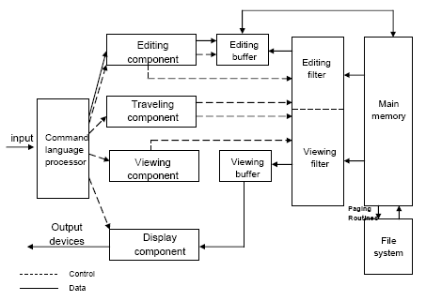
Editor structure

Slide 11
Command Language Processor
Accepts input from the user’s input devices.
Analyzes the tokens and syntactic structure of the commands.
It functions much like the lexical and syntactic phases of a compiler.
The command language processor may invoke the traveling, editing, viewing and display functions.
Editing operations are always specified by the user and display operations are specified implicitly by the other three categories of operations.
Traveling and viewing operations may be invoked either explicitly by the user or implicitly by the editing operations.

Slide 12
Editing Component
It is the collection of modules dealing with editing tasks.
In editing a document, the start of the area to be edited is determined by the current editing pointer maintained by the editing component.
The current editing pointer can be set or reset explicitly by the user or implicitly.
Explicitly by the user issuing traveling commands, such as next paragraph and next screen.
Implicitly as a side effect of the previous editing operation such as a delete paragraph.

Slide 13
Traveling Component
The traveling component of the editor actually performs the setting of the current editing and viewing pointers.
It determines the point at which the viewing and /or editing filtering begins.

Slide 14
Viewing Component
It is a collection of modules responsible for determining the next view.
The start of the area to be viewed is determined by the current viewing pointer.
This pointer is maintained by the viewing component of the editor.
The current viewing pointer can be set or reset explicitly by the user or implicitly by system as a result of previous editing operation.

Slide 15
Display Component
Display Component takes the view from the viewing component and maps it to a physical output device in the most efficient manner.
It produces a display by mapping the buffer to a rectangular subset of the screen, usually a window.

Slide 16
Editing Buffer and Filter
Filtering consists of the selection of contiguous characters beginning at the current point.
The editing filter filters the document to generate a new editing buffer based on the current editing pointer as well as on the editing filter parameters.
Editing Buffer contains the subset of the document filtered by the editing filter.

Slide 17
Viewing Buffer and Filter
When the display needs to be updated, the viewing component invokes the viewing filter.
This component filters the document to generate a new viewing buffer based on the current viewing pointer as well as on the viewing filter parameters.
Viewing Buffer contains the subset of the document filtered by the viewing filter.

Slide 18
A simple example
The user of a certain editor might travel to line 75,and after viewing it, decide to change all occurrences of a word to another word in lines 1 through 50 of the file by using a find/replace command.
As a part of the editing command there is implicit travel to the first line of the file.
Lines 1 through 50 are then filtered from the document to become the editing buffer.
In Line editors, the viewing buffer may contain the current line; in screen editors, this buffer may contain rectangular cut out of the quarter-plane of text.
This viewing buffer is then passed to the display component of the editor, which produces a display by mapping the buffer to a rectangular subset of the screen, usually called a window.

Slide 19
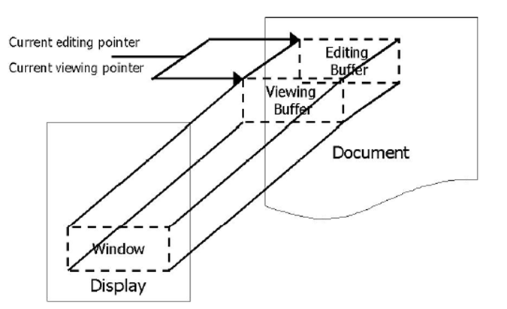

Slide 20
Mapping viewing buffer to window
Windows typically cover the entire screen or rectangular portion of it.
Modern systems can support multiple windows, simultaneously showing different portions of the same file or portions of different file.
This approach allows the user to perform inter-file editing operations much more effectively than with a system only a single window.
The mapping of the viewing buffer to a window is accomplished by two components of the system.
First, the viewing component formulates an ideal view often expressed in a device independent intermediate representation.
Second the display component takes these idealized views from the viewing component and maps it to a physical output device the most efficient manner possible.

Slide 21
Dealing documents
The components of the editor deal with a user document on two levels:
In main memory
In the disk file system
Loading an entire document into main memory may be infeasible.
However if only part of a document is loaded and if many user specified operations require a disk read by the editor to locate the affected portions, editing might be unacceptably slow.

Slide 22
In some systems this problem is solved by the mapping the entire file into virtual memory and letting the operating system perform efficient demand paging.
An alternative is to provide is the editor paging routines which read one or more logical portions of a document into memory as needed.
Such portions are often termed pages.
These pages remain resident in main memory until a user operation requires that another portion of the document be loaded.

Slide 23
Computing Environments
Editors function in three basic types of computing environment:
Time-sharing environment
Stand-alone environment
Distributed environment
In time sharing environment, editor must function swiftly within the context of the load on the computer’s processor, memory and I/O devices.
In stand-alone environment, editors on stand-alone system are built with all the functions to carry out editing and viewing operations – The help of the OS may also be taken to carry out some tasks like demand paging.

Slide 24
In distributed environment, editor has both functions of standalone editor, to run independently on each user’s machine and like a time sharing editor, contend for shared resources such as files.

